Slide 1
Milestone 4
CST-135 Matt Sievers

Slide 2
Project URLs
Code – https://github.com/Malleas/CST-135/tree/master/src/Milestone
Storyboard - https://www.meistertask.com/projects/jzoif109jd/join/
Video - https://www.loom.com/share/efc37a85239f4bd7a3e94cbc4546159a

Slide 3
Design Plans
Using examples from this weeks assignments, implement the same methods used in readCarsFromFile and saveCarsToFile. Both can be used in the same extend to complete the requirements. Use them as a framework and adapt as needed.
Add type to base contact so that a contact can be specified in the data supplied and logic applied based on type. Can be used to help add needed items for each type of contact.
Add contacts from list to book at the beginning of console app
Append new contacts created in app to existing file.
Minor updates needed to interface methods.

Slide 4
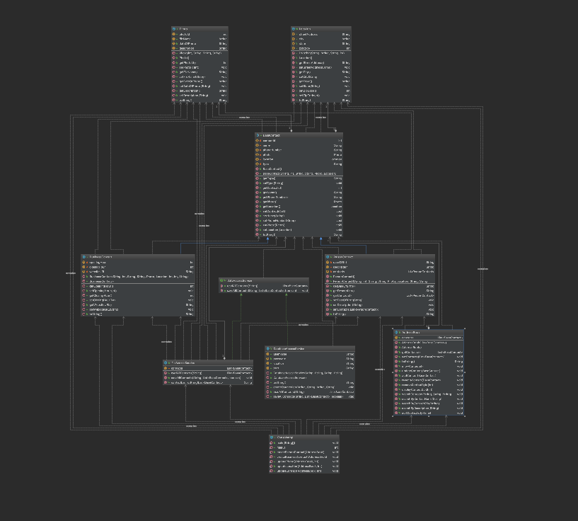
UML

Slide 5
Data Directory

Slide 6
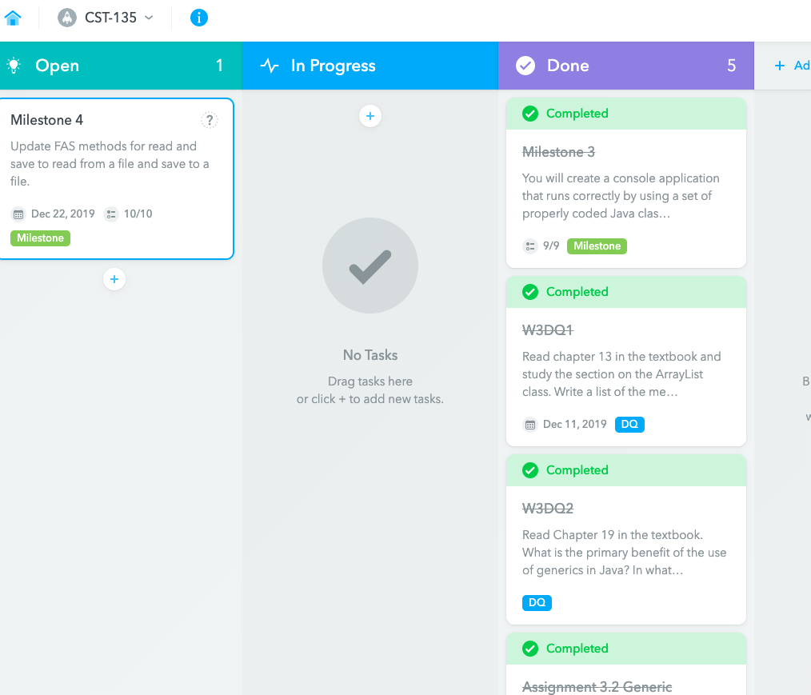
Story Board

Slide 7
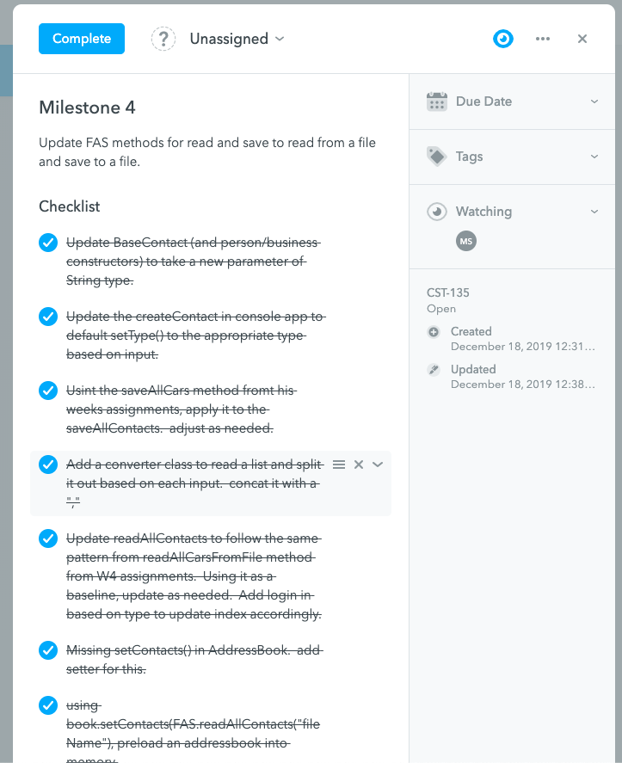
Milestone 4 Story

